Slide 1
Diabetic Retinopathy Detection and Classification using Different Models
Group 23 40221947 Amanpreet Singh
40225754 Ashish Upadhyay
40196467 Rajat Sharma
40248554 Tript Dhudi

Slide 2
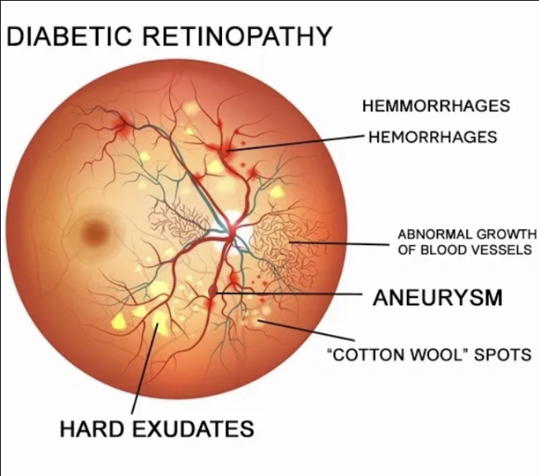
Introduction
Diabetic retinopathy is a serious eye condition that affects millions of people worldwide. It occurs when high blood sugar levels damage the blood vessels in the retina, leading to vision loss and even blindness. This condition can have a significant impact on people's lives, making it difficult for them to perform everyday tasks or even work.
As an AI project, we aim to detect and classify diabetic retinopathy at an early stage to prevent further damage and improve treatment options. Our goal is to create a system that can accurately identify the condition and provide timely intervention to those who need it.

Slide 3
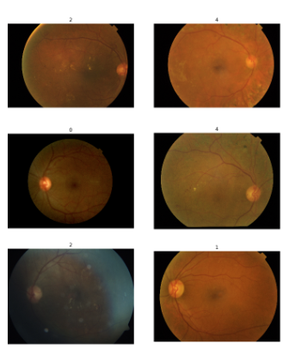
Image dataset selection
The dataset used in this project is sourced from the Diabetic Retinopathy (resized) on Kaggle. It comprises 35,126 retinal scan images resized to 28x28 pixels. The dataset is categorized into five directories representing different severity levels of diabetic retinopathy: No DR, Mild, Moderate, Severe, and Proliferate DR. Each directory contains images corresponding to its respective severity level, facilitating classification based on the presence and severity of diabetic retinopathy. This dataset offers a valuable opportunity for developing and evaluating algorithms in diabetic retinopathy detection using deep-learning models, benefiting researchers in the field of diabetic retinopathy diagnosis.

Slide 4
Proposed Methodologies
Different methodologies for the detection and classification of diabetic retinopathy using supervised and semi-supervised learning approaches, specifically decision tree and deep neural network (DNN) methods.
Decision Tree Supervised Learning: Decision trees are used to classify retinal images into different stages of diabetic retinopathy. The model learns hierarchical decision rules based on features extracted from color fundus photographs.
Decision Tree Semi-Supervised Learning: In cases where labeled data is limited, a semi-supervised learning approach can be employed. A small portion of the dataset is labeled, and a decision tree model is trained using these examples. The trained model is then used to classify the remaining unlabeled data, leveraging both labeled and unlabeled data for improved accuracy.
Deep Neural Network (DNN) Supervised Learning: Convolutional Neural Networks (CNNs) are utilized for image classification tasks. In this case, a CNN-based supervised learning approach is chosen for detecting and classifying diabetic retinopathy using color fundus photographs. CNNs are well-suited for capturing spatial features and patterns in images.
Evaluation and Comparison: Researchers should carefully evaluate and compare the performance of these methodologies, considering factors such as available labeled data, dataset size, problem complexity, and computational resources. The most suitable approach can be determined based on the evaluation results.
These methodologies offer different ways to tackle the detection and classification of diabetic retinopathy, providing researchers with options to consider based on their specific needs and constraints.

Slide 5
Decision Tree:Supervised Vs Semi supervised Learning
Problem
Data Preprocessing
Model Training and Evaluation
Model Performance
Model Comparison

Slide 6
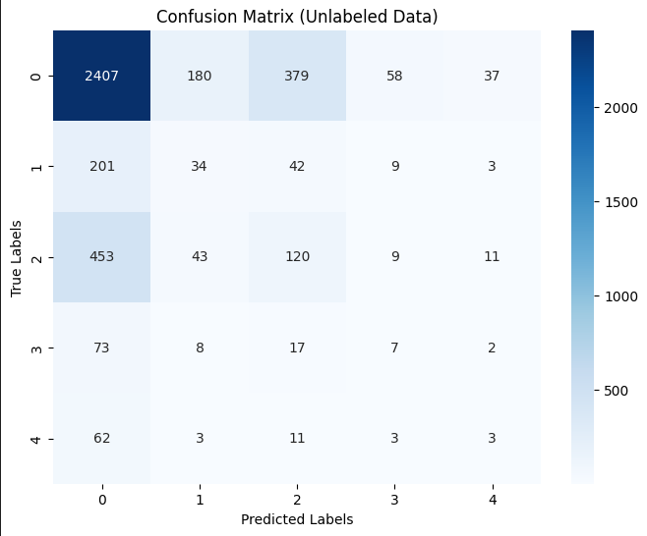
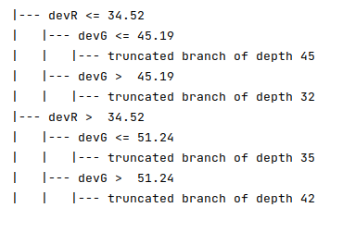
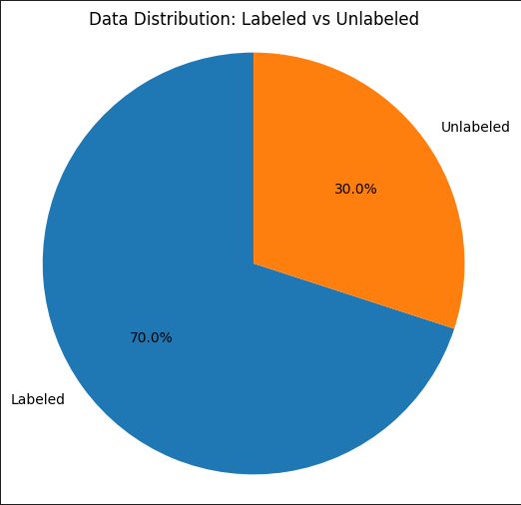
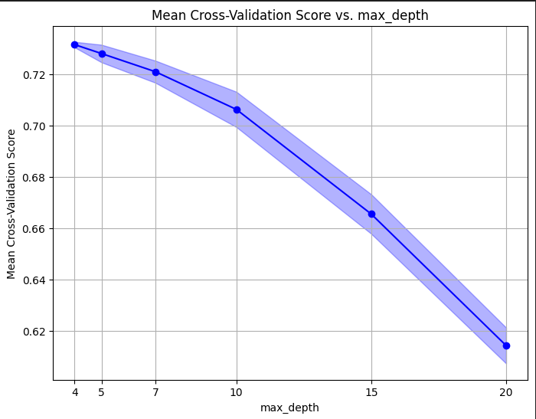
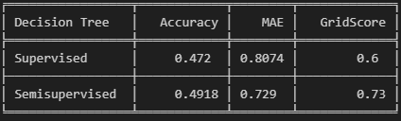
Decision Tree: Outputs

Slide 7
Convolutional Neural Networks
A type of deep learning model
Designed to automatically learn and extract hierarchical representations of data,
The key components of a CNN are convolutional layers, pooling layers, and fully connected layers.
The main advantages of CNNs include Local feature learning, Translation invariance, Hierarchical representation.
Densenet Pretrained Model

Slide 8
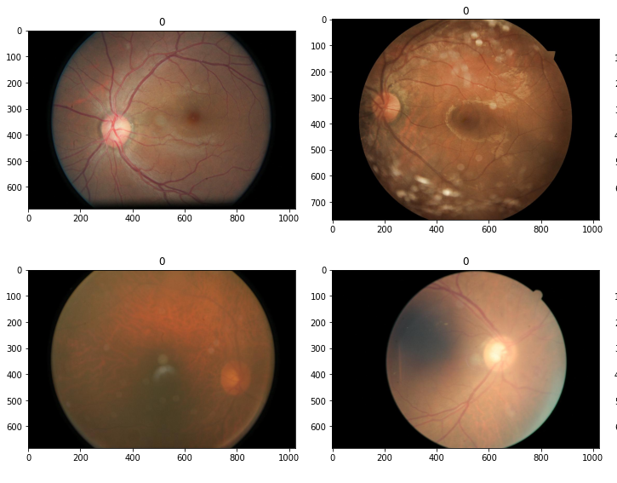
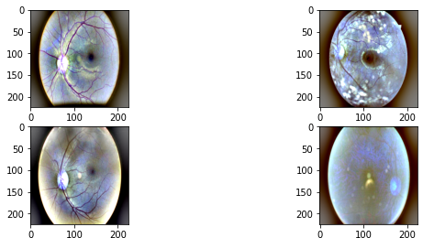
Data Preprocessing for CNN
Resampling the Data
Image Resizing into (224 x 224)
Applying GaussianBlur
Diving the data into Training and Testing Set.
Input Images
Output Images

Slide 9
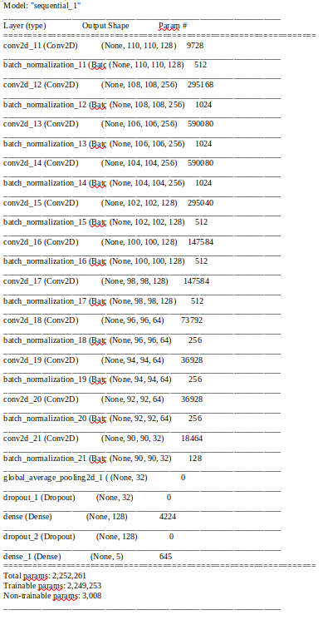
CNN Model
Sequential architecture with layers added sequentially.
Convolutional layer with 128 filters, 5x5 kernel size, and stride of 2 (ReLU activation).
Batch normalization applied after each convolutional layer.
Multiple convolutional layers with different filter sizes (256, 128, 64, 32) and ReLU activation.
Global average pooling layer for dimension reduction.
Dropout regularization with a rate of 0.5.
Two dense layers (128 and 5 units) with sigmoid activation for multilabel classification.
Binary cross-entropy loss, Adam optimizer (lr=0.0001), and accuracy metric.

Slide 10
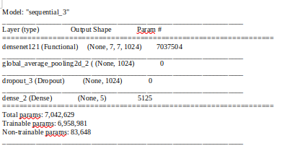
Densenet Model
DenseNet121
Pre-trained weights:
Total layers: 121.
Top layer excluded.
Sequential API is used.
DenseNet layer is added.
GlobalAveragePooling2D layer reduces spatial dimensions.
Dropout regularization (rate: 0.5) prevents overfitting.
Dense layer (5 units, sigmoid activation) for multilabel classification.
Binary cross-entropy loss function.
Adam optimizer (lr: 0.00005).

Slide 11
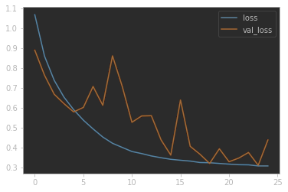
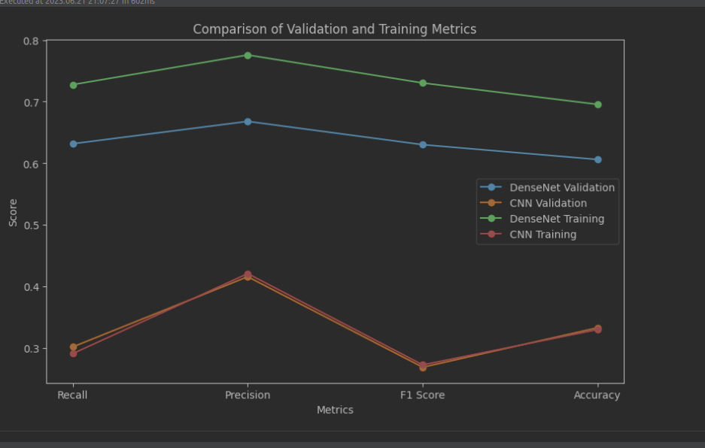
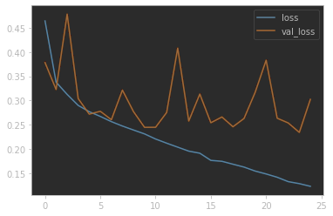
Model Evaluation and Comparison
Densenet
Comparison of Different Metrics
Custom CNN

Slide 12
Model Evaluation and Comparison
Future Scope
DenseNet model outperformed the CNN model in evaluation metrics.
DenseNet model showed superior performance in recall, precision, F1 score, and accuracy for both validation and training sets.
Tune the DenseNet Model more and improve Overall score.
Web Application
Early Detection and Screening, Automated Diagnosis etc.

